Slide 1
1. OBJECTIVES
By the end of this session you will be able to:
Describe the history of development of the CPU.
Explain how cache, pipelines and superscalar operation can improve performance.
Objectives
History of Computers
Computer Architecture
‹#›

Slide 2
2. HISTORY OF COMPUTERS
Charles Babbage is considered to the father of computer.
He designed “Difference Engine” in 1822
He designed a fully automatic “Analytical engine” in 1842 for performing basic arithmetic functions
His efforts established a number of principles that are fundamental to the design of any digital computer
Objectives
History of Computers
Computer Architecture
‹#›

Slide 3
2. HISTORY OF COMPUTERS
First computers programmed by wiring.
1944:
EDVAC (Electronic Discrete Variable Automatic Computer) – first conceptual stored program computer.
Von Neumann, Eckert, & Mauchly.
1948:
First (prototype) stored program computer – Mark I at Manchester University.
Harvard Mark III & IV. Howard Aiken.
Harvard Architecture / fully automatic / controlled by paper tape / reliable / beginning modern computer era.
Objectives
History of Computers
Computer Architecture
‹#›

Slide 4
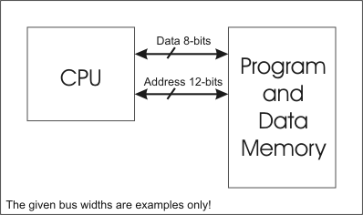
3. COMPUTER ARCHITECTURE
3. 1. VON NEUMANN
Classic computer architecture.
Data and program instructions stored in same memory.
Fetch-execute cycle.
Suffers from Von Neumann ‘bottleneck’.
3. Computer Architecture
3.1. Von Neumann
3.2. Harvard
3.3. Modified Harvard
Bottleneck. Small compared to main memory & rate at which today's CPUs work.
‹#›
Notes:
‹#›

Slide 5
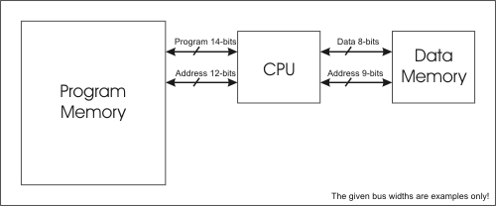
3.2. HARVARD
Data and programs stored in separate memory areas.
Allows for faster operation.
Simultaneous access of both data and programs
Allows data and instruction bus to be different sizes.
3. Computer Architecture
3.1. Von Neumann
3.2. Harvard
3.3. Modified Harvard
‹#›

Slide 6
3.3. MODIFIED HARVARD
CPU
Memory
Hybrid approach – combination of von Neumann and Harvard
Single Main Memory for both Data and Program
Separate High-speed Memory Caches for Data and Instructions
Simultaneous access of both data and programs from caches
Data Cache
3. Computer Architecture
3.1. Von Neumann
3.2. Harvard
3.3. Modified Harvard
Data
Instr. Cache
Addr
7

Slide 7
4.CPU
Control Unit
CPU consists of transistors, combined together as gates.
CPU works in cycles – fetch, decode, execute.
Usually each step handled by different part of CPU.
Where would adders be found?
Arithmetic
& Logic
Unit
Registers
4.CPU 4.1. Types of CPU Design
4.2. Example Architecture
4.3. Architecture Bit Sizing
‹#›

Slide 8
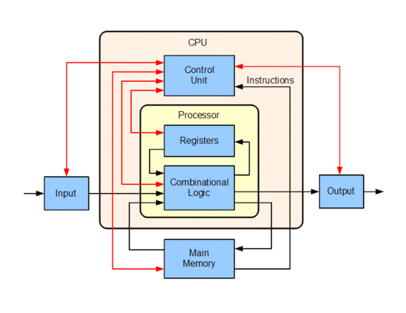
4.CPU
4.CPU 4.1. Types of CPU Design
4.2. Example Architecture
4.3. Architecture Bit Sizing
CPU Architecture
‹#›

Slide 9
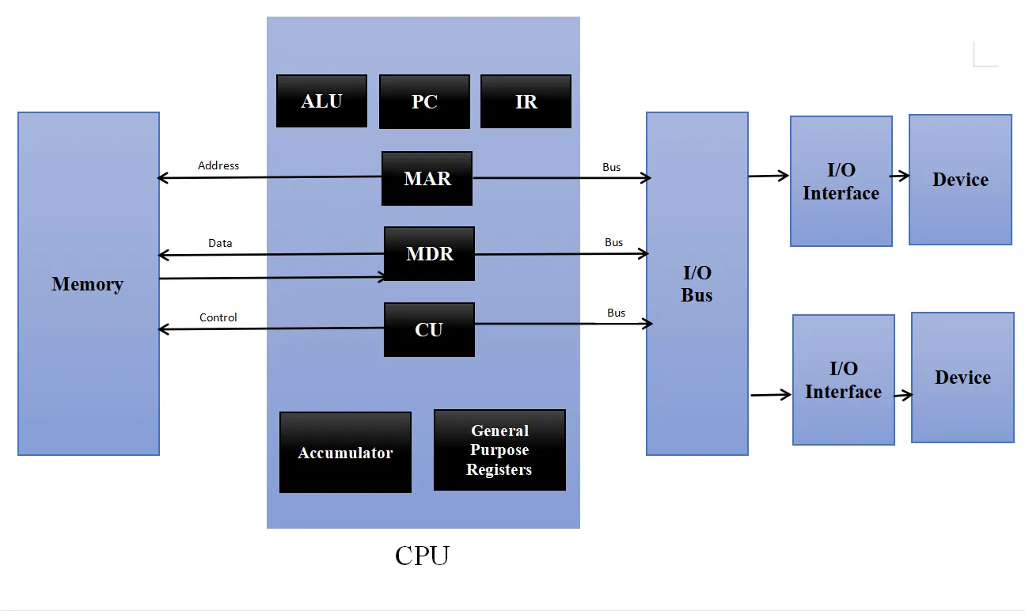
4.CPU
4.CPU 4.1. Types of CPU Design
4.2. Example Architecture
4.3. Architecture Bit Sizing
CPU Architecture
‹#›

Slide 10
4.1. TYPES OF CPU DESIGN
Accumulator:
All ALU operations work on data in accumulator (special register).
Stack:
All ALU operations work on data stored on the stack.
Register-register:
All ALU operations work on data stored in registers.
4.CPU 4.1. Types of CPU Design
4.2. Example Architecture
4.3. Architecture Bit Sizing
‹#›

Slide 11
4.2. EXAMPLE ARCHITECTURE
4.CPU 4.1. Types of CPU Design
4.2. Example Architecture
4.3. Architecture Bit Sizing
Memory (RAM)
Stack
Data Bus
Control Unit
Arithmetic Logic
Unit
Registers
Accumulator is a special register, stored in here
‹#›

Slide 12
CODE SEQUENCE EXAMPLES
Stack | Acc | Reg-Mem | Load-Store
Push A | Load A | Load R1, A | Load R1, A
Push B | Add B | Add R1, B | Load R2, B
Add | Store C | Store R3, C | Add R3, R2, R1
Pop C |  |  | Store R3, C
4.CPU 4.1. Types of CPU Design
4.2. Example Architecture
4.3. Architecture Bit Sizing
Examples of: C = A + B
‹#›

Slide 13
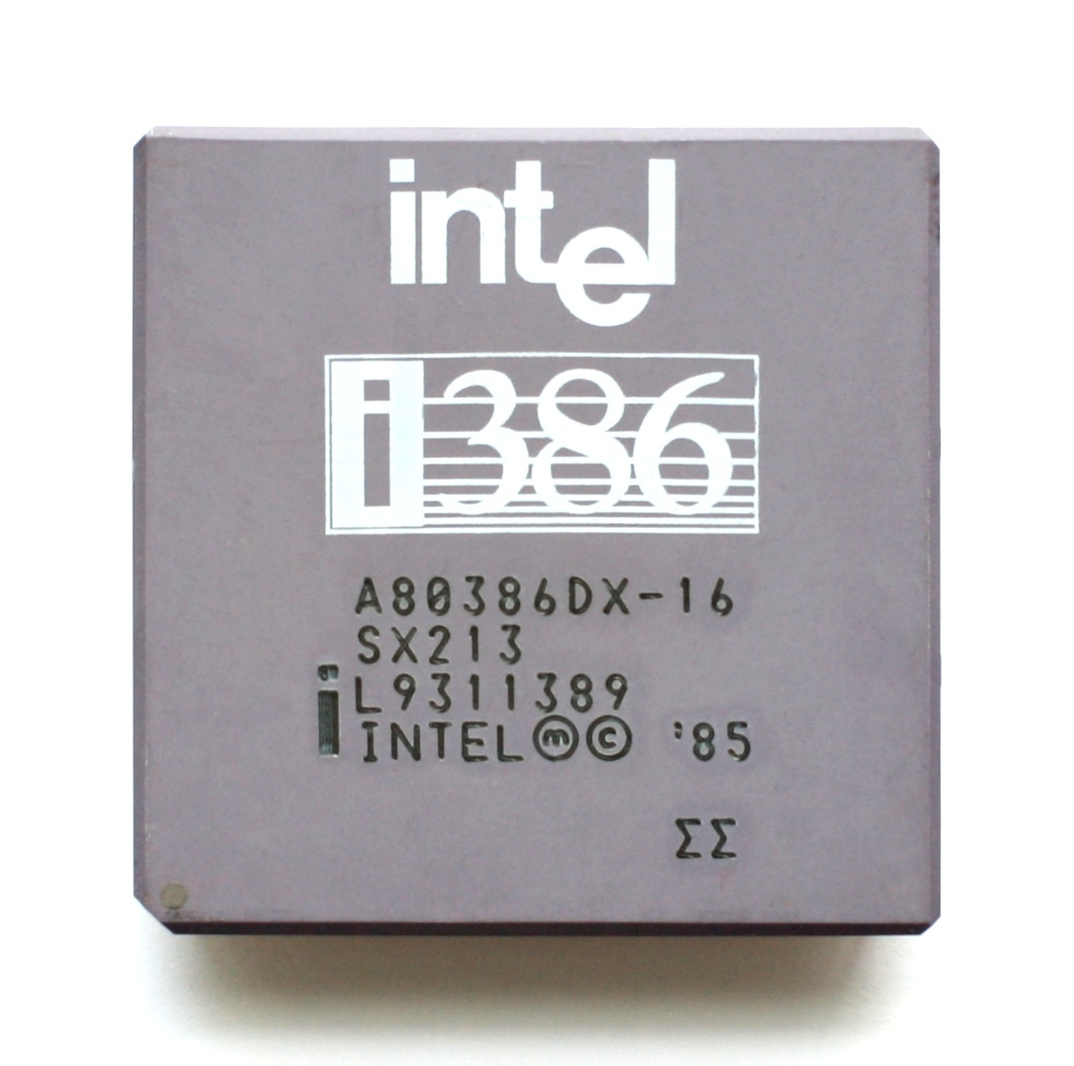
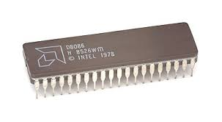
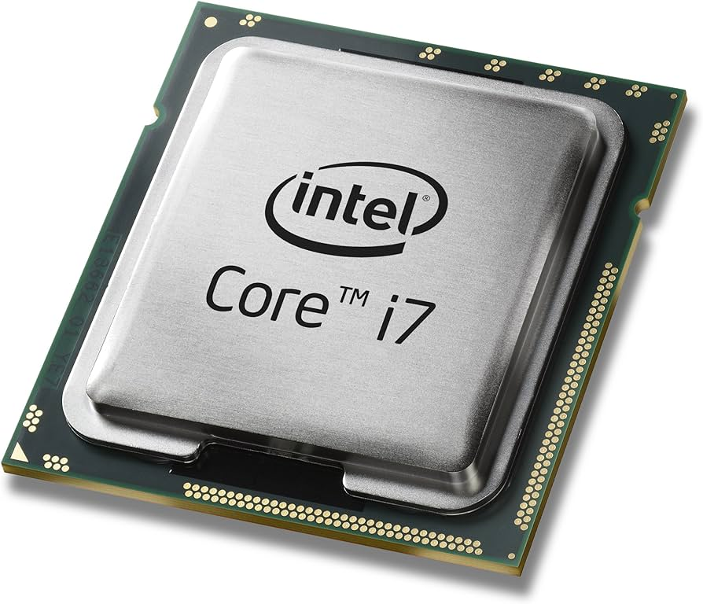
4.3. ARCHITECTURE BIT SIZING
Most CPU’s are rated by the number of bits they have:
16 bit (8086).
32 bit (80386).
64 bit (Core 2)
4.CPU 4.1. Types of CPU Design
4.2. Example Architecture
4.3. Architecture Bit Sizing
INTEL 8086
Released: June 8, 1978,
INTEL 80386 (i386)
Released: October, 1985
INTEL CORE i7
Released: November, 2008
‹#›

Slide 14
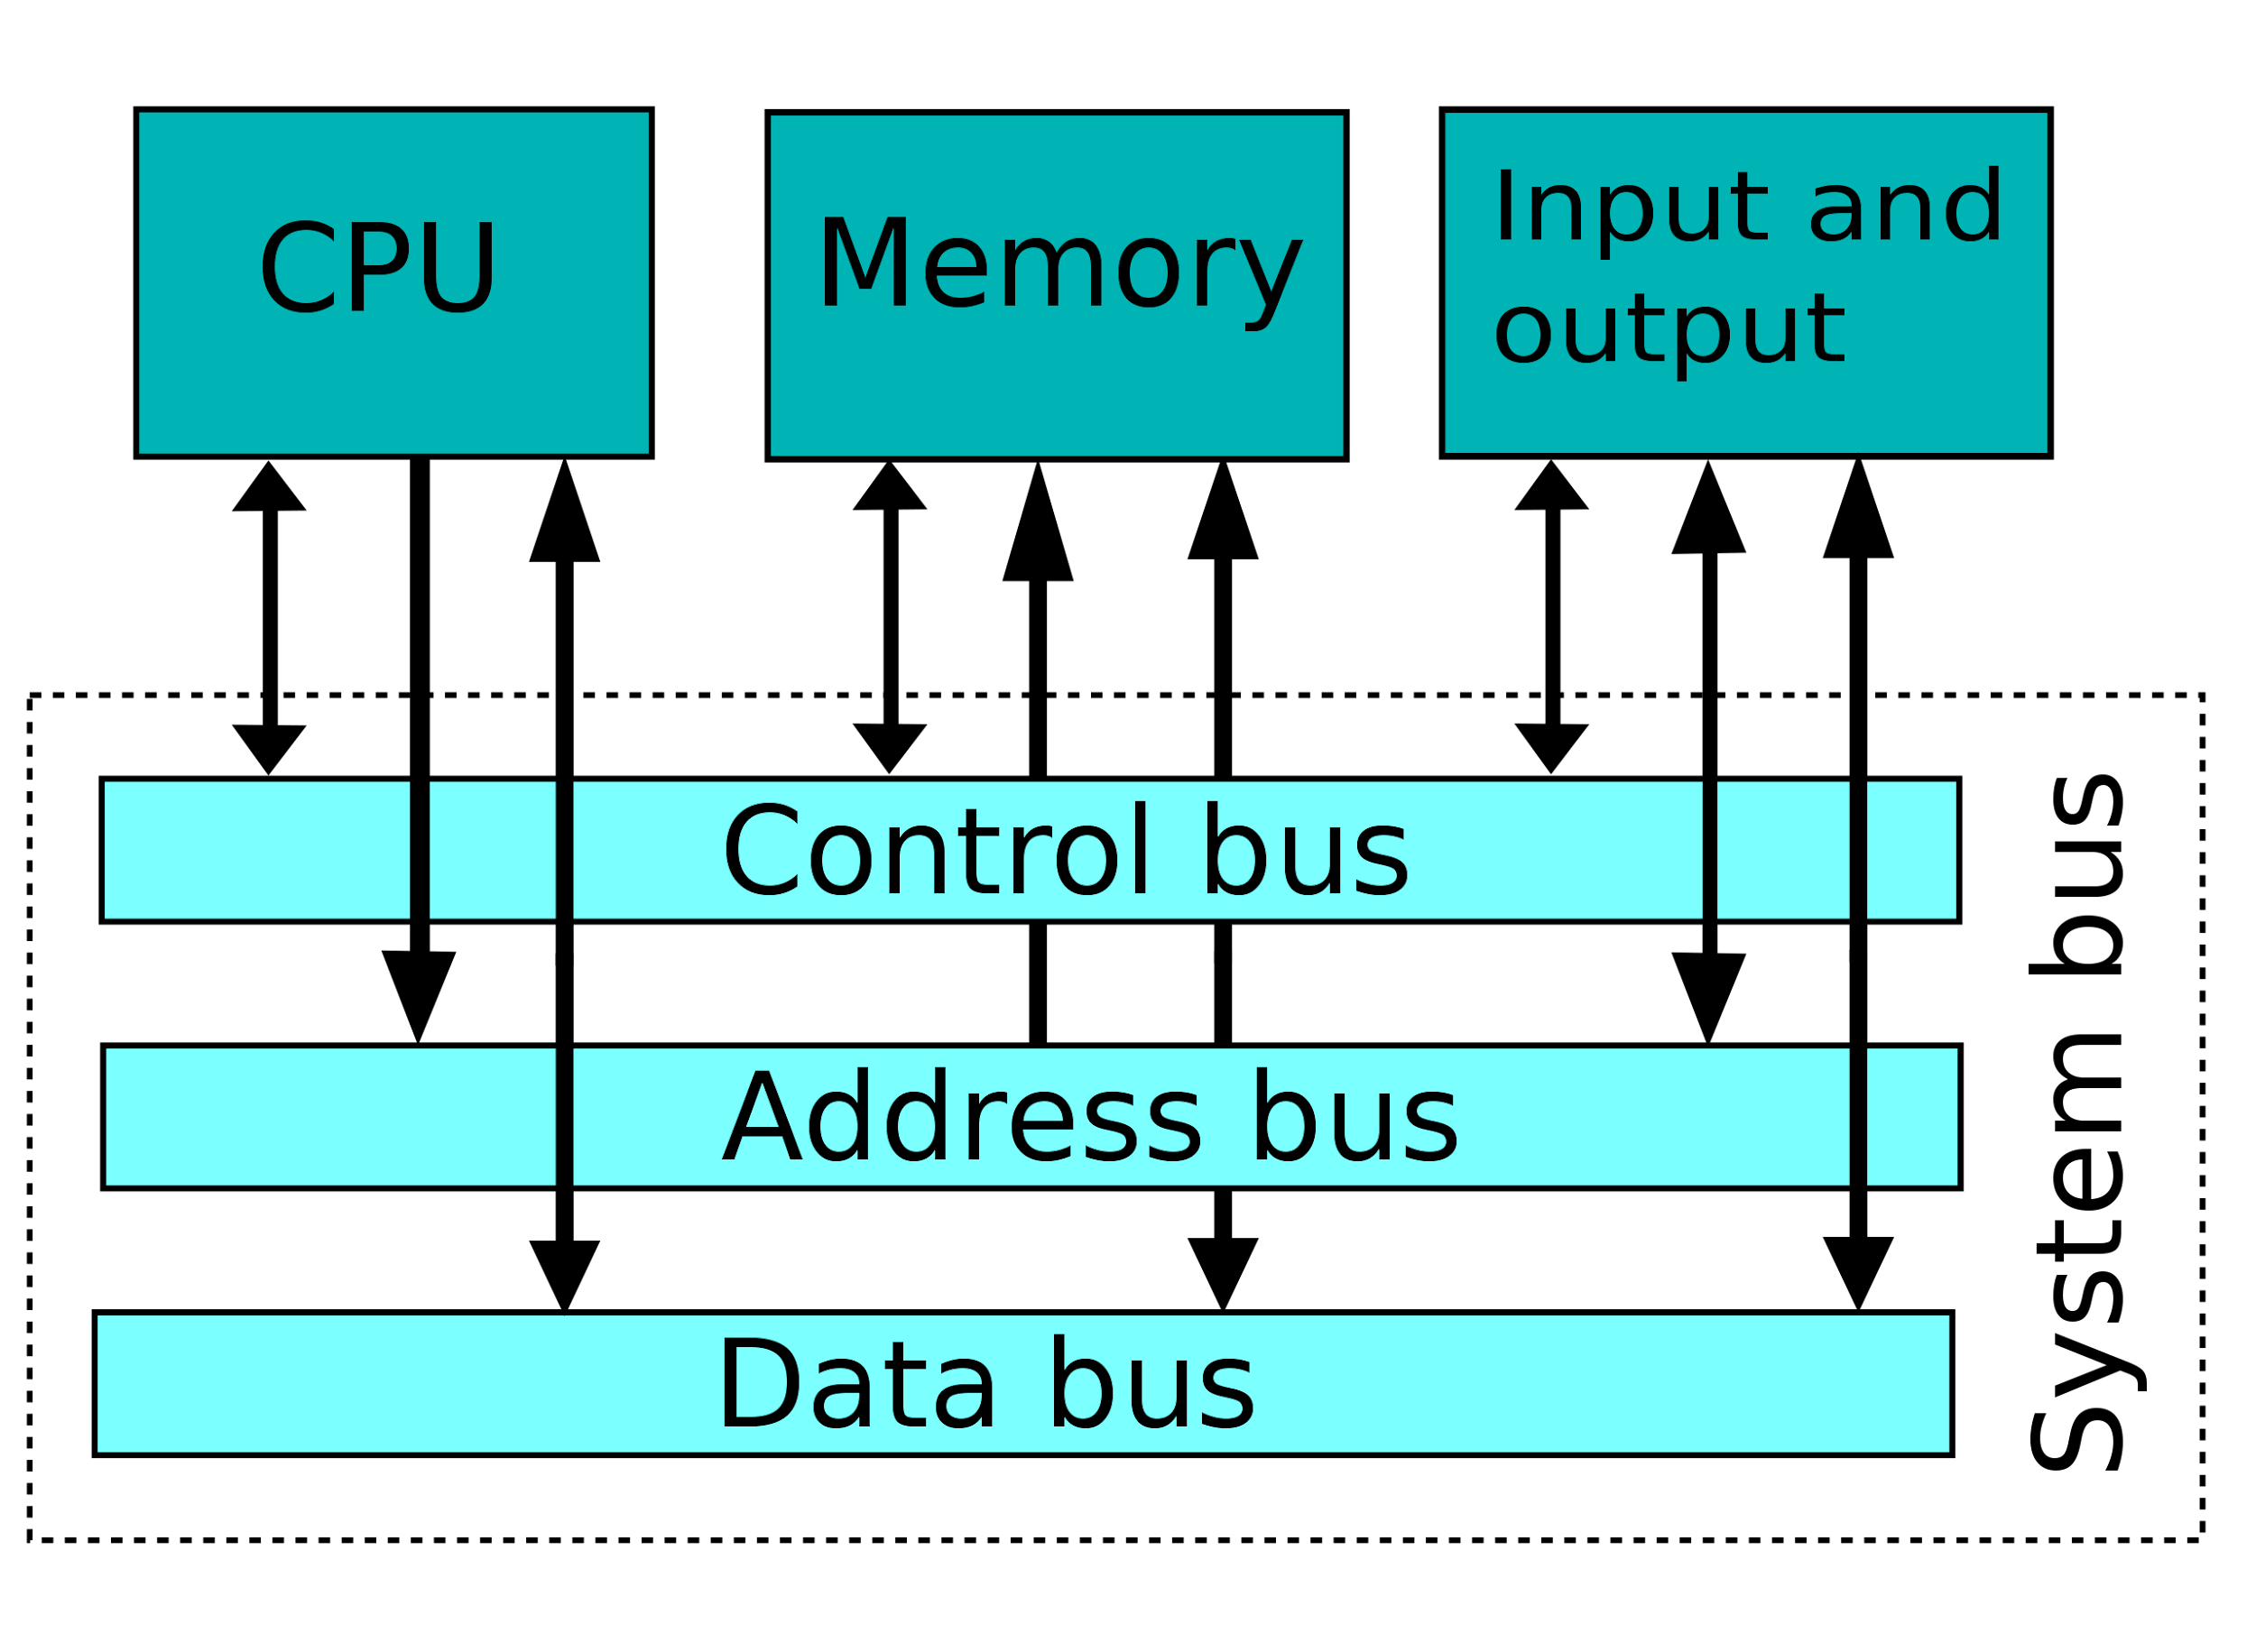
5. BUS
A bus is a high-speed internal connection. Buses are used to send control signals and data between the processor and other components.
Three types of bus are used.
Address bus - carries memory addresses from the processor to other components bus is unidirectional. such as primary storage and input/output devices. The address is unidirectional.
Data bus - carries the data between the processor and other components. The data bus is bidirectional.
Control bus - carries control signals from the processor to other components. The control bus also carries the clock's pulses.
5 Bus
5.1. Data Bus
5.2. Address Bus
5.3. Register Sizing
‹#›

Slide 15
5.1. DATA BUS
PC = Program counter. Register / holds the address of the current instruction.
CPU
Memory
Determines how much data can be copied from / to memory at a time (cycle?).
Advantages of Harvard vs. Von Neumann?
0000
PC
0001
5 Bus
5.1. Data Bus
5.2. Address Bus
5.3. Register Sizing
4003
Address Bus
4002
Read
10110001
4003
4004
????
Data Bus
IR
IR = Instruction register. Holds the current instruction while it is executed.
‹#›

Slide 16

5.2. ADDRESS BUS
Determines how much memory can be accessed.
Matched with program counter / pointer
etc
5 Bus
5.1. Data Bus
5.2. Address Bus
5.3. Register Sizing
Address
D
Bus
A0
E
etc
etc
etc
etc
etc
C
O
D
etc
An
E
n bits wide
R
etc
Chip Select
read write
Data 0 Data n
Control Bus Data Bus
‹#›
Notes:
‹#›
Data coming in and out at the bottom.

Slide 17
5.2. ADDRESS BUS
Each ‘line’ in memory corresponds to a bit in a register (the MAR – memory address register).
So 8 lines = 8 bits = 2 ⁸ = ??
32 lines = 32 bits = 2 ³² = 4GB.
64 lines = 64 bits = 2 ⁶⁴ = 18.5 EB (exabytes), 1.85x10¹⁹ bytes
5 Bus
5.1. Data Bus
5.2. Address Bus
5.3. Register Sizing
‹#›

Slide 18
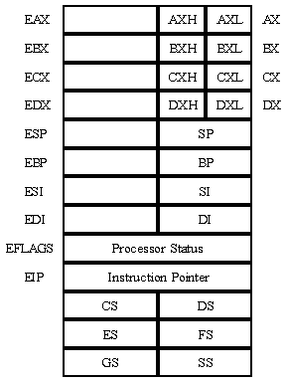
5.3. REGISTER SIZING
EAX,EBX,ECX,EDX: general purpose registers.
ESP: stack pointer (top).
EBP: Stack base Pointer.
EFLAGS: condition codes.
EIP: program counter (instruction pointer).
Registers are the internal ‘memory’ of a CPU.
They determine the maximum memory that can be addressed (PC).
They determine the size of ALU operations.
Can be 8-bit, 16-bit, 32-bit, 64-bt (or more!)
5 Bus
5.1. Data Bus
5.2. Address Bus
5.3. Register Sizing
‹#›

Slide 19
NEXT STEPS…
Late fifties / early sixties number computers available increased rapidly.
Generally each generation had a different architecture than previous one (enhancements / improvements).
Different instruction sets.
Machines customised for customers.
Was this a problem?
IBM solution: system 360.
NEXT STEPS…
‹#›

Slide 20
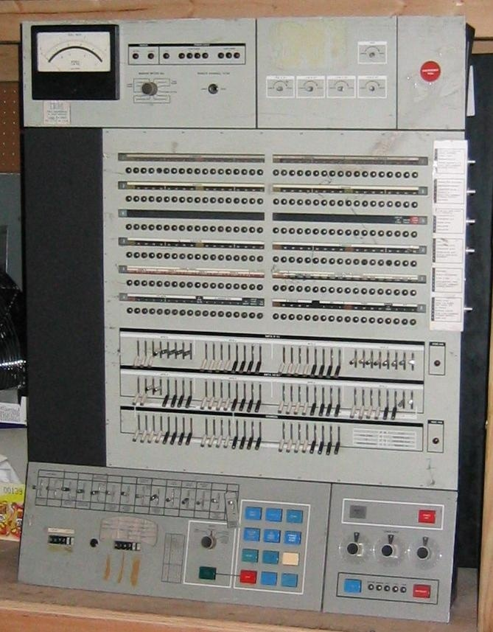
SYSTEM 360 (PROTOCOL)
System 360 popularised use of microcode across the ‘range’.
i.e. same instruction set.
Example: Multiplication.
Any program written for one model would work on all.
Binary compatibility.
System 360
‹#›

Slide 21
6. CISC - COMPLEX INSTRUCTION SET COMPUTER
Originally, CPU speed and Memory speed the same.
Instructions varied in size, 1 – 5 words (16 bit).
Depending on data bus size, could take up to 5 cycles / instruction.
Decoding may include microcode.
CISC – designed to make programming easier – either for assembly programmer or compiler programmer.
6. CISC - Complex
Instruction Set Computer
6.1. Evolution
6.2. RISC - Reduced instruction set computer
6.3. Instruction Usage
6.4. RISC v. CISC
Example: VAX Vs. MIPS
‹#›

Slide 22
6.1. EVOLUTION
Mid seventies – John Cocke @ IBM initiated research on performance of microcoded CPU’s.
1980 – Patterson built on this work, coined term RISC.
Conclusions:
Most programs use only small % of available instructions.
Microcoded instructions not always best / most efficient way of performing task.
6. CISC - Complex
Instruction Set Computer
6.1. Evolution
6.2. RISC - Reduced instruction set computer
6.3. Instruction Usage
6.4. RISC v. CISC
Example: VAX Vs. MIPS
‹#›

Slide 23
6.2. RISC - REDUCED INSTRUCTION SET COMPUTER
RISC should really be Reduced Complexity Instructions (RISC)
Ideal specification:
Each instruction executes in one cycle – increases processing efficiency.
No microcode.
All instructions work on registers, except load / store.
May need more store as have more instructions.
6. CISC - Complex
Instruction Set Computer
6.1. Evolution
6.2. RISC - Reduced instruction set computer
6.3. Instruction Usage
6.4. RISC v. CISC
Example: VAX Vs. MIPS
‹#›

Slide 24
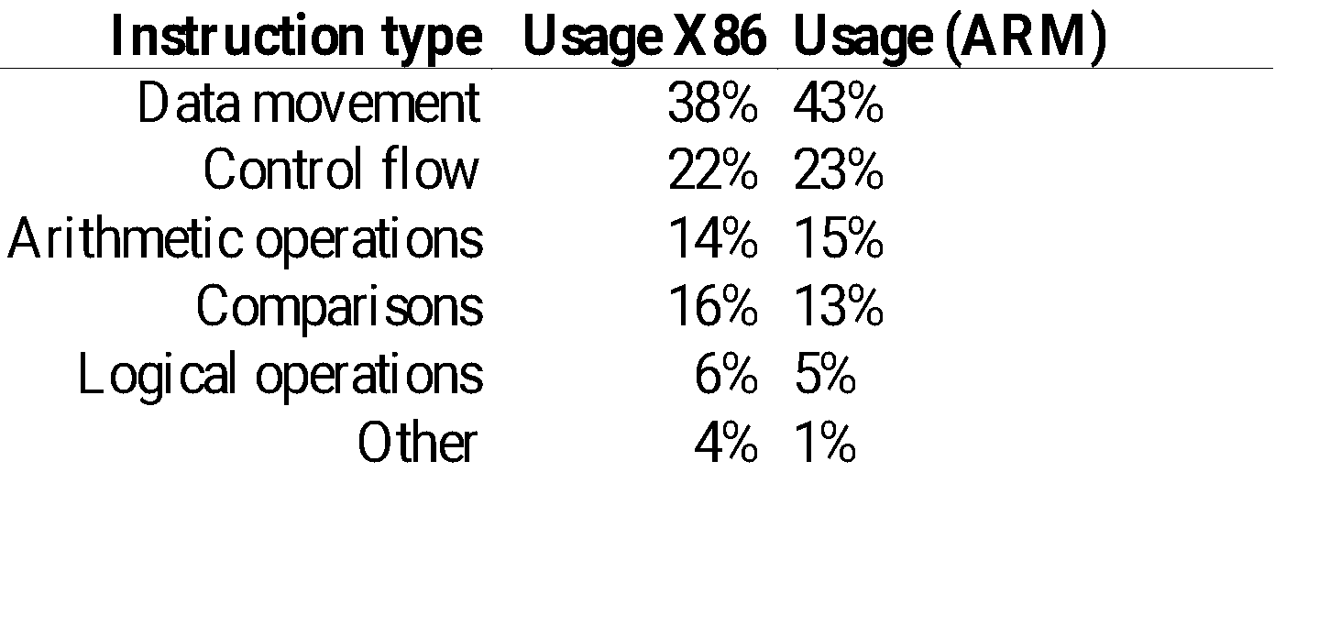
6.3. INSTRUCTION USAGE
6. CISC - Complex
Instruction Set Computer
6.1. Evolution
6.2. RISC - Reduced instruction set computer
6.3. Instruction Usage
6.4. RISC v. CISC
Example: VAX Vs. MIPS
Which is the most important type of instruction to optimise?
‹#›

Slide 25
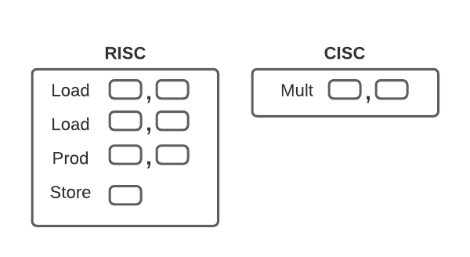
6.4. RISC V. CISC
Performance:
RISC optimises cycles / instruction.
CISC optimises instructions per program.
Trade – off.
How do we optimise cycle time?
6. CISC - Complex
Instruction Set Computer
6.1. Evolution
6.2. RISC - Reduced instruction set computer
6.3. Instruction Usage
6.4. RISC v. CISC
Example: VAX Vs. MIPS
‹#›

Slide 26
EXAMPLE: VAX VS. MIPS
Description | Value (mean)
VAX CPI | 9.9
MIPS CPI | 1.7
CPI Ratio (VAX/MIPS) | 5.8
Instruction Ratio (MIPS/VAX) | 2.2
RISC factor | 2.7
6. CISC - Complex
Instruction Set Computer
6.1. Evolution
6.2. RISC - Reduced instruction set computer
6.3. Instruction Usage
6.4. RISC v. CISC
Example: VAX Vs. MIPS
Cycles Per Instruction (CPI): instructions may take one or more cycles to complete.
VAX – CISC architecture. MIPS – RISC architecture.
RISC factor = CPI ratio / Instruction ratio.
‹#›

Slide 27
7. MODERN ENHANCEMENTS
How do we improve cycle times?
Cycle time = I-time + E-time where
I-time = time taken to fetch instruction from memory (or cache).
E-time – time taken by ALU to execute instruction.
7. Modern Enhancements
7.1. Clock Speed
7.2. Clock Cycles
‹#›

Slide 28

7.1. CLOCK SPEED
System clock like ‘heartbeat’ for system.
All system synchronised to clock.
Ideal condition is CPU performs one instruction (or more!) per clock cycle.
7. Modern Enhancements
7.1. Clock Speed
7.2. Clock Cycles
‹#›

Slide 29
7.2. CLOCK CYCLES
Cycles measured in Hertz.
1 MHz = 1 million cycles/sec.
1 GHz = 1,000 million cycles/sec.
Remember ideal: > 1 instruction/cycle!
7. Modern Enhancements
7.1. Clock Speed
7.2. Clock Cycles
‹#›

Slide 30

8.OPERATIONS (ORIGINAL CISC)
Analogy: The fast food outlet…
8. Operations(Original CISC)
1. Fetch – press button, open door.
2. Decode – take order.
‹#›

Slide 31
8. OPERATIONS
8. Operations(Original CISC)
3. Execute – make food.
4. Store – handover to customer.
‹#›

Slide 32

9. CACHE
Expensive and high speed memory.
Speed up memory retrieval.
Relatively small amount.
9. Cache
9.1. Cache and Memory Hierarchy
Instructions ->
‹#›

Slide 33
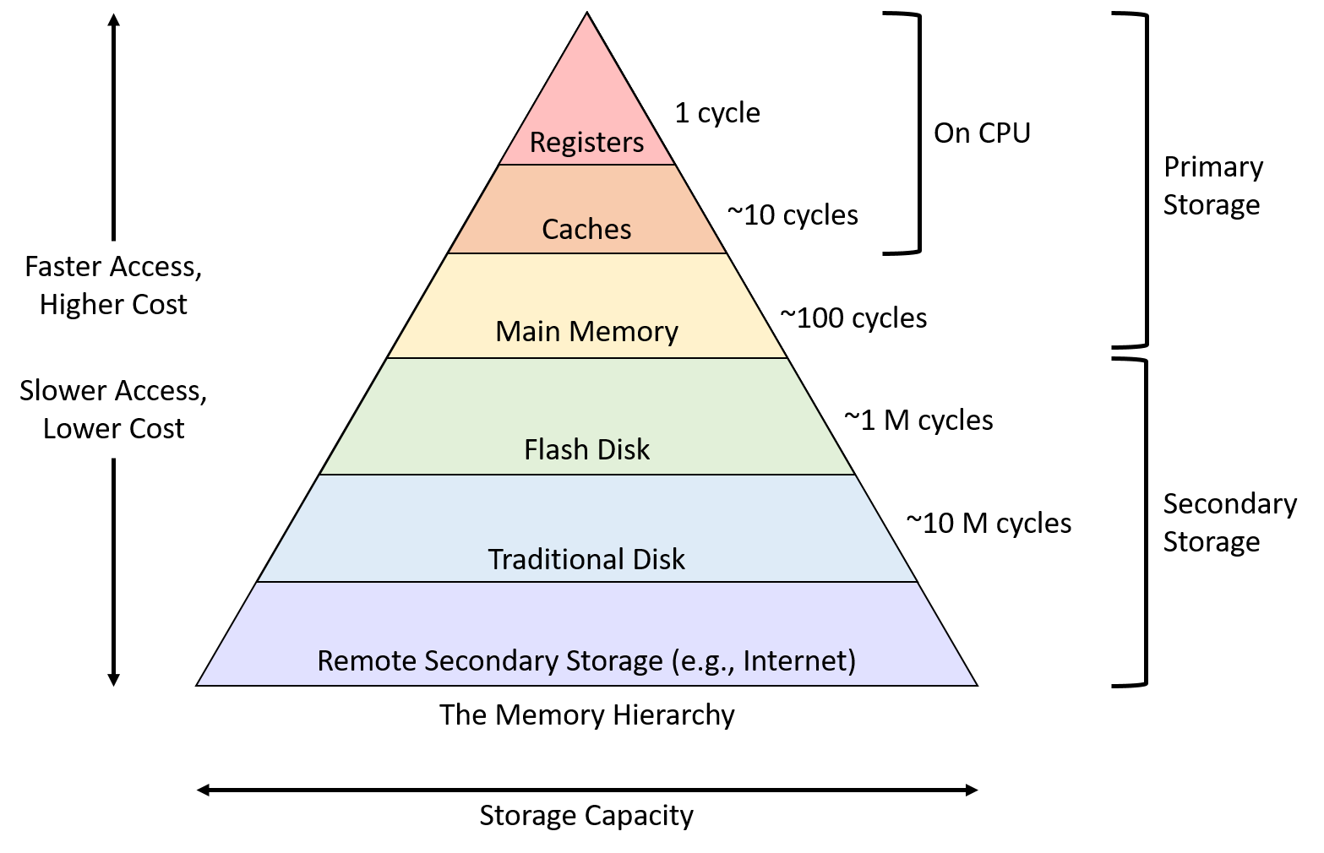
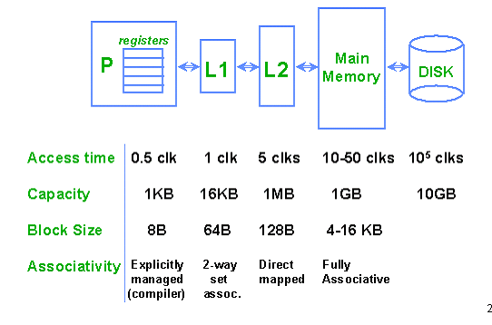
9.1. CACHE AND MEMORY HIERARCHY
9. Cache
9.1. Cache and Memory Hierarchy
‹#›

Slide 34
10.PIPELINE
10. Pipeline
decoding
executing
storing
simultaneously
‹#›

Slide 35
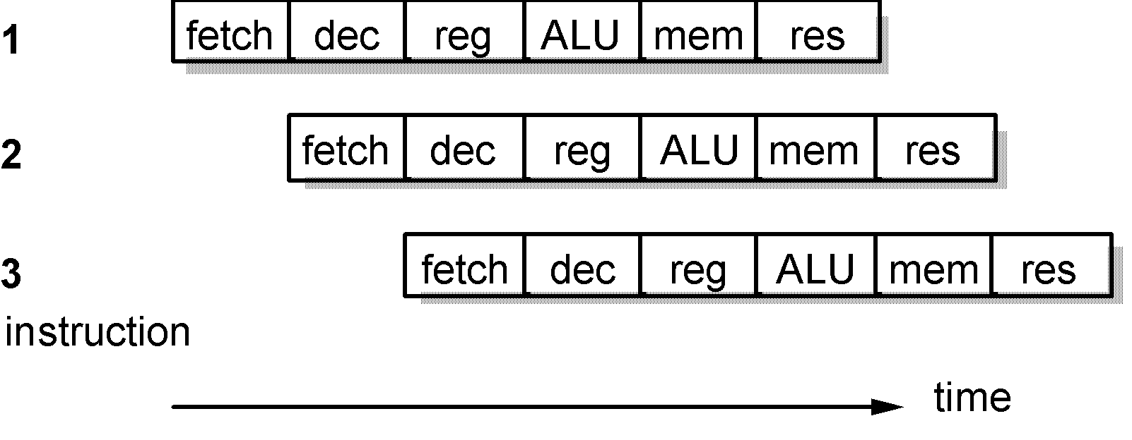
10. PIPELINES
Concept of using each functional unit simultaneously.
Theoretically:
N stage pipeline = n* increase in speed.
Problems in practice? Pipeline Hazards.
Instruction 2 operand is the output from Instruction 1.
Stall / read-after-write hazard.
Branching.
10. Pipeline
‹#›
Notes:
‹#›
Fetch (fetch)
Decode (dec)
Access operands from register (reg)
Combine the operands to form the result or a memory addr. (ALU)
Access memory for a data operand, if necessary (mem)
Write the result back to the register bank (res)

Slide 36
11. SUPERSCALAR
Decode
Store
Execute
11. Superscalar
Multiple, independent, functional units.
Instruction-level parallelism.
‹#›

Slide 37
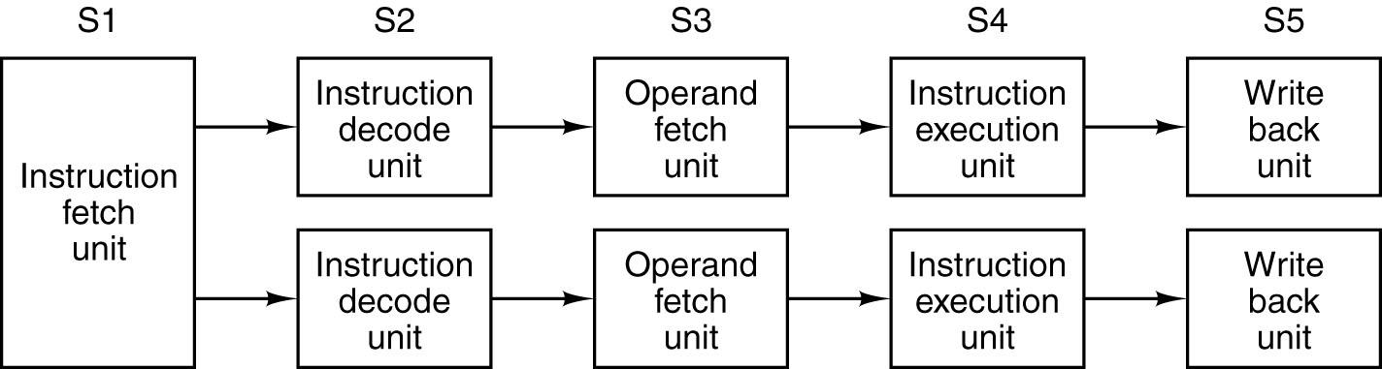
11. SUPERSCALAR
Concept of adding more functional units.
Theoretically:
N units = N instructions processing in parallel.
Problems in practice? Order of instruction?
Which instructions can be perform simultaneously?
E = a + b
F = c + d
G = E * F
11. Superscalar
Common instruction fetch unit.
‹#›

Slide 38
12. CO-PROCESSORS
Concept of providing hardware to perform specialist tasks (floating point, multimedia, etc).
Theoretically:
‘Special’ tasks processed simultaneously, faster than ALU.
Problems in practice?
Examples – MMX (Flynn, SIMD).
Single Instruction, Multiple Data streams (SIMD).
One instruction operates on multiple data items at the same time.
MMX – Hardware / multimedia performance boost.
12. Co-processors
‹#›

Slide 39
14. POST CISC
Most modern processors tend to combine the best of CISC (backward compatibility) with that of RISC (performance).
X86 processors (Intel, AMD, etc) tend to use a hybrid design.
14. Post CISC
14.1. Pentium Pro
14.2. Pentium 4
‹#›

Slide 40
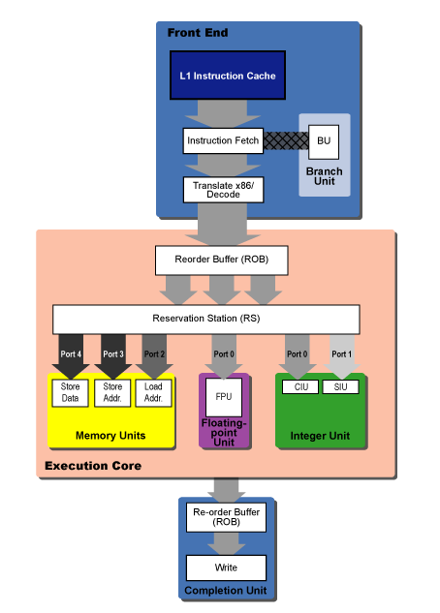
13. PENTIUM PRO
Division between front end and back end.
Front end – fetch & decodes, convert to micro-ops.
Reorder buffer (ROB).
Reservation station.
14. Post CISC
14.1. Pentium Pro
14.2. Pentium 4
‹#›

Slide 41
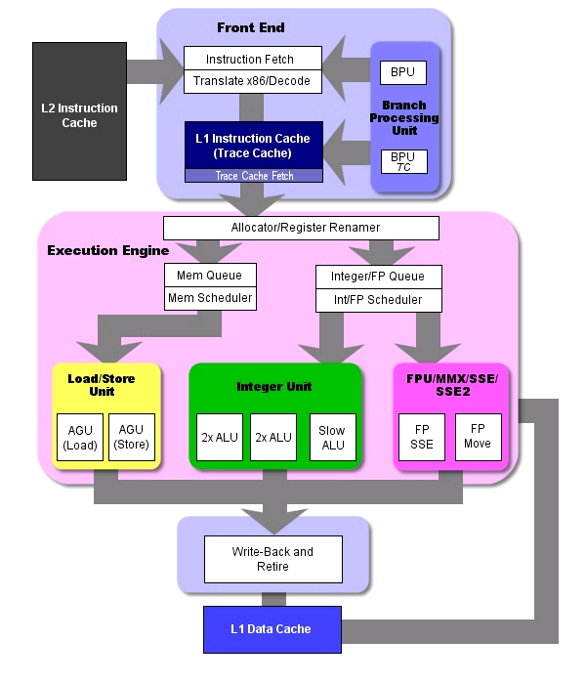
14. PENTIUM 4
16k trace cache (12,000 micro-ops) (L1).
8 general purpose registers.
128 rename registers.
2 simple ALU (double speed).
1 complex ALU.
FPU (dual pipeline, stack based).
SSE(Streaming SIMD Extension).
14. Post CISC
14.1. Pentium Pro
14.2. Pentium 4
‹#›

Slide 42
SUMMARY
Storage options (stack, accumulator or register).
CISC vs. RISC.
Modern enhancements (cache, pipelines, superscalar).
Modern processor examples.
Summary
‹#›

Slide 43


